Slide 1

Spotify Tracks A Data-Driven Approach to Predicting Music Streaming Popularity
Team
Daniel Kuffel
Jesse Reeves
Supriya Vadakkeveetil

Slide 2

Ever Wondered
What makes a song track popular?
Music
Tempo
Energy
Loudness

Slide 3

Project Overview
Goal & Deliverable
Predict Streams on a song based on different audio features/ variables
An interactive app that could help predict the streams on a song.
Resources
Kaggle
Spotify API Documentation
Notes:
Our goal is to use Machine Learning to

Slide 4

Benefit
Artists and Labels can analyze
Understand who listens to their music and tailor marketing strategies.
Identify trends in popular music to inform creative decisions.
Gain insights into the potential popularity of new tracks

Slide 5

Data Collection
Kaggle -Spotify songs Data set
Spotify API - Used Web scraping to extract the stream count
Combined dataset used for analysis

Slide 6
Data Cleaning & Pre-processing
Data Cleaning
Identify null values, check them manually on Spotify
Stream Count values with No streams were misrepresented
SQLite database
Import data from a CSV file into an SQLite database and use Pandas to query the data stored in the database.
Read info to a DataFrame
Pre-processing
Converted the datatypes (Float and int)
Calculated the months since release of the album
Converted the duration from milliseconds to Seconds

Slide 7
Features
Acousticness – Whether the track is acoustic
Danceability – how suitable a track is for dancing based on tempo, rhythm, beat
Duration – duration of the track
Energy – perceptual measures of intensity and activity
Instrumentalness – vocal content
Tempo – speed or pace of a given piece
Valence – Positiveness of a track. Tracks with high valence sound more positive while with low valence sound more negative
Liveliness – higher liveliness represents increased probability of the track being performed live
Loudness – quality of sound
Speechiness - presence of spoken word in a track
https://developer.spotify.com/documentation/web-api/reference/get-audio-features
Notes:
Effect these features will have on the Stream count

Slide 8

Regression Models

Slide 9

Elastic Net
Utilizes penalties from both lasso and ridge to improve regularization.
Useful in cases of high multicollinearity, or with variables that may be linear.
Lasso: Shrinks values toward the mean.
Ridge: Corrects overfitting in models.
Final R^2: .157

Slide 10
Random Forest
Supervised learning algorithm that uses decision trees.
Was able to handle the data the most accurately.
Prediction can be made on more variables more efficiently.
Final R^2: .779

Slide 11

K Fold

Slide 12

K-Fold Scores
K-Fold value: 5
Cross Validation Scores: .4822, .4609, .4641, .4768, .6878
Average Score: .5144
Equal to a coin toss.

Slide 13

XG Boost eXtreme Gradient Boosting
Excellent for High accuracy predictions
Regarded as one of the most effective machine learning algorithms

Slide 14

XG Boost
About:
Regularization: Prevent overfitting/complexity
Tree Construction: Optimal Splits
Categorical Features: Automatic
Our XGBoost Model:
Learning_rate: .6
Max_depth: 11
N_estimators: 1500
Accuracy Score:
.7937

Slide 15
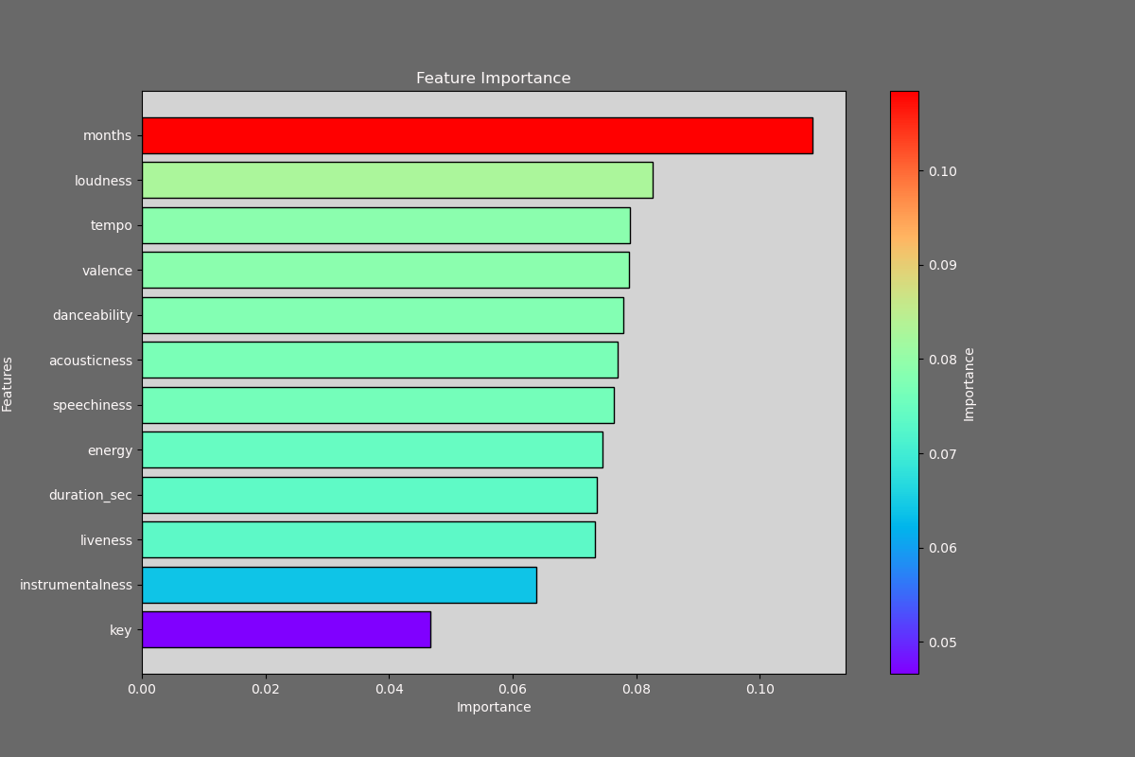
Analysis & Demo
Based on our Machine Learning model
Features ranked based on the importance

Slide 16
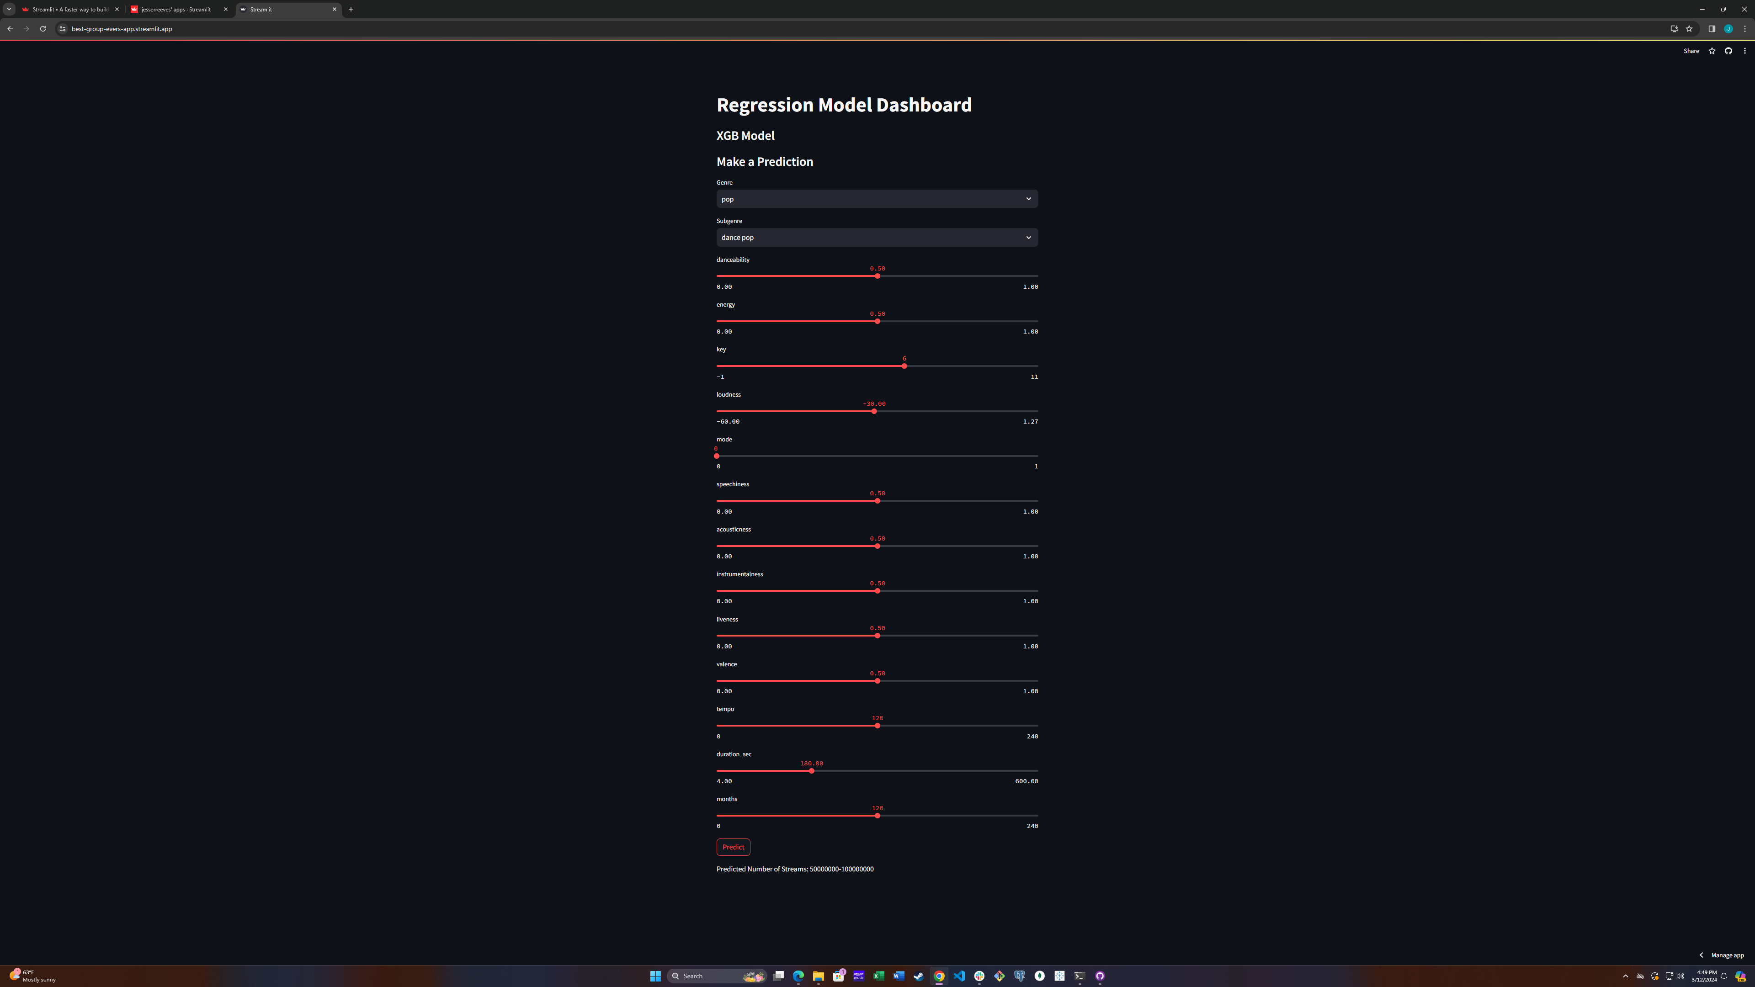
Analysis & Demo
Make a prediction using our Streamlit App to get the Number of Streams based on the features of your song

Slide 17

Thank you

